Slide 1

GROUP 10 MEMBERS
Asangana Paul Fleming
FE23A014
Fontem Junior Nkonganyik
FE23A063
Suinyuy Mathias Mahla
SignalSense
FE23A144
Nfor Godwill Kongnje
UI Design & Implementation
FE23A108
Ronald Namwene Vefonge
PROJECT 3: Crowdsensed Drive Test Mobile App for Coverage Prediction
FE22A295
TASK 5 · GROUP 10 · Internet Programming & Mobile Programming

Slide 2
INTRODUCTION
Project Overview
The UI plays a critical role in ensuring usability, accessibility, and efficient data collection.Since the application is intended to be used by ordinary smartphone users to collect network performance measurements, the interface must be intuitive, lightweight, and easy to navigate regardless of the user's technical expertise.
TASK 5 FOCUS
UI Design & Frontend Implementation using Flutter/Dart
📱 The Application’s Identity
📡 Visual Interface Design
Containing the App name, brand identity, Logo and typography.
Designed with figma.
🗺️ Front-End Implementation
Built with Flutter, to aid cross-platform access improving coverage.

Slide 3
APP IDENTITY
SignalSense — Brand Identity
BRAND REPRESENTATIONS
Connectivity
Network Intelligence
Mobility
Coverage Prediction
Data Collection
What does the name mean?
"Signal" — cellular measurements from smartphones "Sense" — detect, monitor and interpret network conditions in real-time
Overall branding promotes:
Trust · Reliability · Technical Sophistication
Essential qualities for a professional network monitoring platform.

Slide 4
VISUAL DESIGN SYSTEM
Color Palette & Typography
COLOR IDENTITY
Blue
Green
Orange
Red
White
Trust, Communication
& Reliability
Network Health &
Successful Measurements
Warnings & Weak
Signal Conditions
Coverage Holes &
Poor Network Areas
Clean, Readable
Interface Background
TYPOGRAPHIC OBJECTIVES
Readability: Clear font sizes, spacing & visual hierarchy for quick metric interpretation
Consistency: Uniform layouts, colors, and navigation patterns throughout the app
Accessibility: Sufficient color contrast, touch-friendly controls for broad user participation
Professional Appearance: Clean layouts and well-chosen color scheme to build user confidence

Slide 5
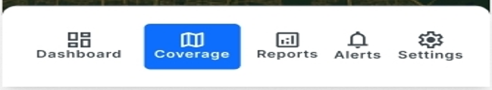
NAVIGATION DESIGN
Navigation Architecture & Design Approach
CORE NAVIGATION AREAS
🏠
Dashboard
🗺️
Coverage Analysis
Central control panel
Map-based visualization
📶
Network Monitoring
👤
User Profile
Real-time signal data
Preferences & account
📊
Measurement Collection
⚙️
Settings
Data acquisition screen
App configuration

Slide 6
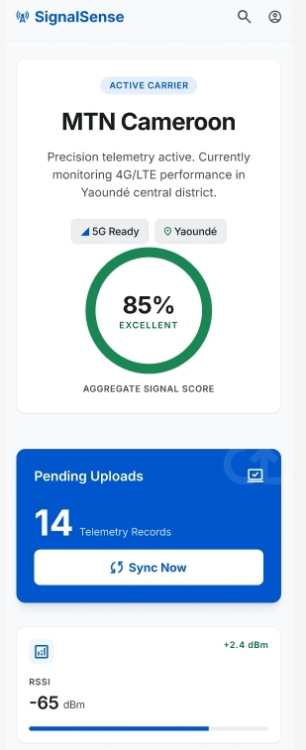
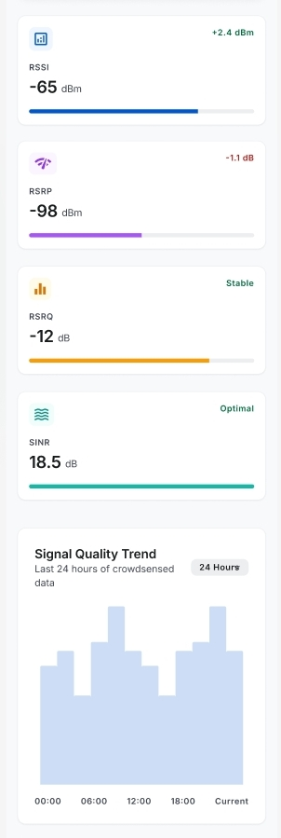
DASHBOARD DESIGN
Dashboard Interface Design
The dashboard acts as the central control panel of the SignalSense application, giving users an immediate at-a-glance overview of network conditions.
KEY INFORMATION DISPLAYED
📶
Current Signal Strength
RSSI & aggregate signal score
📍
GPS Location
City & coordinates display
📈
Measurement Statistics
Telemetry record count
🔄
Data Sync Status
Pending uploads & Sync Now
📡
Network Information
Carrier & technology (4G/5G)
🟢
Coverage Indicators
Excellent / Fair / Poor
✏️ Designed in Figma · figma.com/design/rmgpSjdOEEgGXqQf7AJY0j

Slide 7
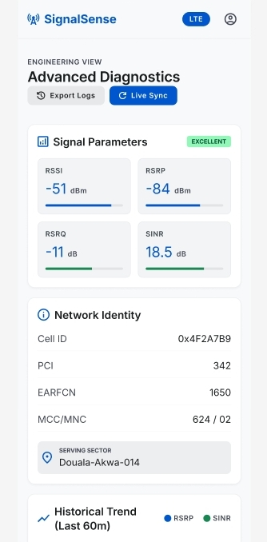
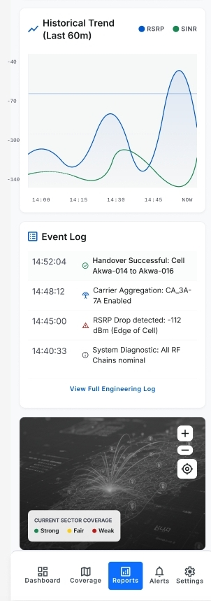
DATA COLLECTION
Network Measurement Collection Screen
MEASURED PARAMETERS
RSRP
Reference Signal Received Power (dBm)
RSRQ
Reference Signal Received Quality (dB)
SINR
Signal-to-Interference-plus-Noise Ratio
RSSI
Received Signal Strength Indicator (dBm)
Cell ID
Serving cell identifier (hex format)
GPS
Latitude/longitude coordinates
Timestamp
Date & time of measurement
All measurements updated in real-time via Flutter dynamic widgets

Slide 8
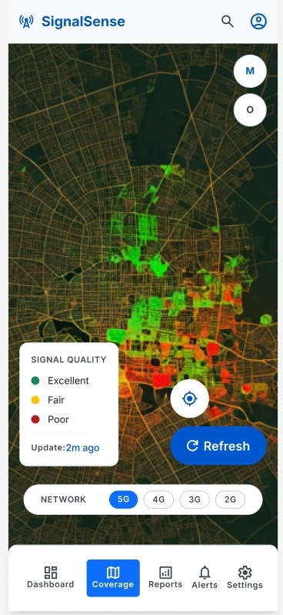
COVERAGE MONITORING
Coverage Monitoring Interface
WHAT THE MAP SHOWS
Excellent Coverage
Strong signal areas shown in green — optimal network performance
Fair Coverage
Acceptable signal shown in yellow-orange — some degradation
Poor Coverage / Holes
Weak or no signal shown in red — requires network improvement
NETWORK FILTER:
5G
4G
3G
2G
Fig. 4: Coverage Map with Signal Quality Overlay

Slide 9
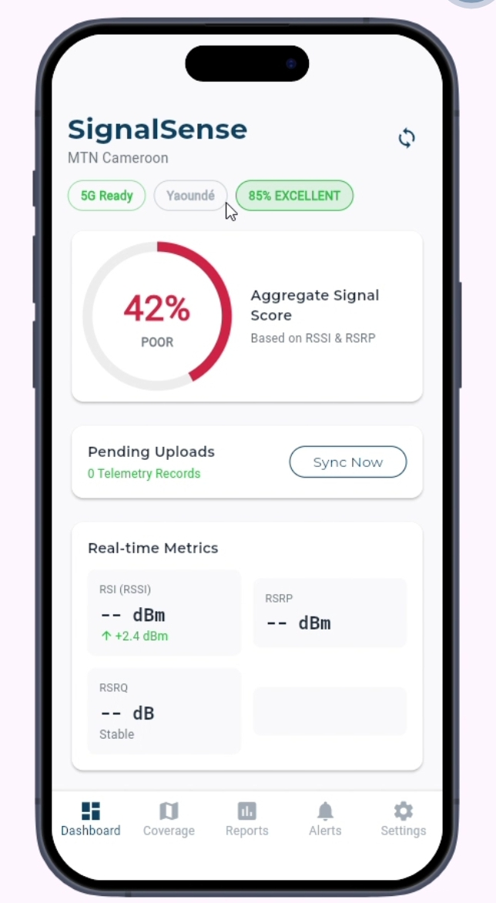
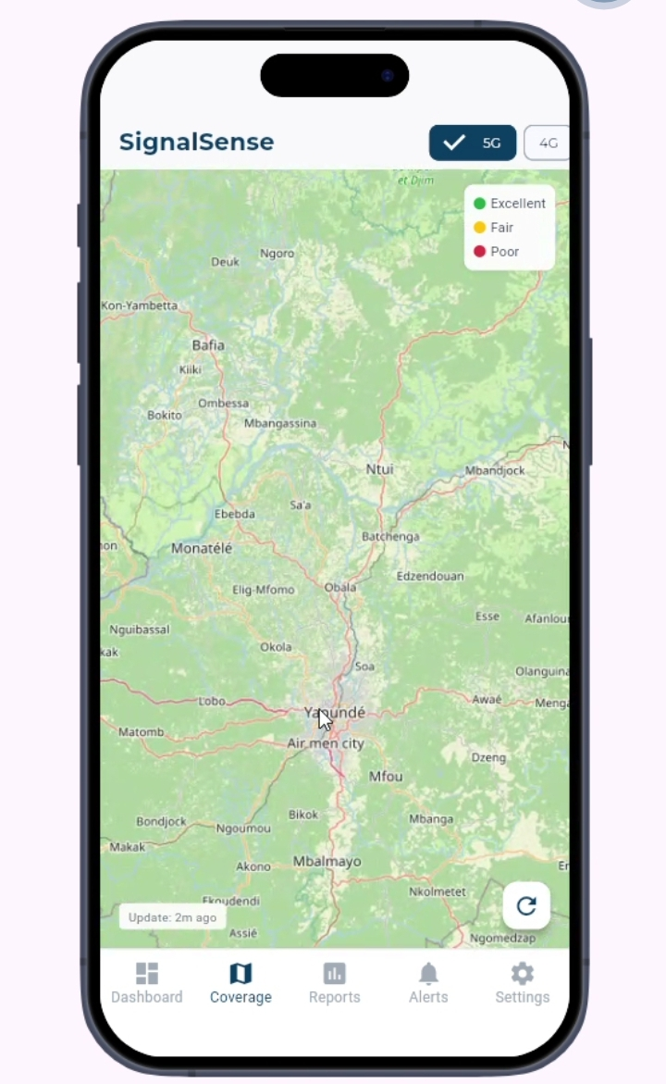
FRONTEND IMPLEMENTATION
Flutter & Dart Implementation
WHY FLUTTER WAS SELECTED
🔀
Cross-Platform
Single codebase for Android & iOS — reduces development time and maintenance costs
⚡
High Performance
Compiles to native machine code; smooth animations & low latency for real-time data
🧩
Rich UI Components
Cards, charts, maps, navigation components — all leveraged for an intuitive UX
🔁
Hot Reload
Rapid UI testing & refinement without full app restart — improved productivity
ARCHITECTURE: Presentation Layer → Business Logic Layer → Data Layer

Slide 10
CONCLUSION
Summary & Conclusion
01
Clear App Identity Established
04
Offline-First Architecture
SignalSense branding built around connectivity, network intelligence, and modern digital technology — promoting trust and reliability.
Continuous measurement collection with local SQLite storage and automatic synchronization — critical for low-connectivity areas.
Figma-Based Visual Prototyping
Security & Privacy Built-In
02
05
Security & Privacy Built-In
05
Full UI prototype developed in Figma covering Dashboard, Data Collection, Coverage Monitoring, and all major screens before implementation.
No registration required. Input validation, permission management, and session protection ensure data integrity and user privacy.
No registration required. Input validation, permission management, and session protection ensure data integrity and user privacy.
03
Flutter/Dart Frontend Implemented
High-performance, cross-platform app from a single codebase. Riverpod state management, MethodChannels for native APIs, flutter_map, sqflite.
SignalSense — Transforming smartphones into powerful sensing devices for mobile network coverage prediction
Group 10 · Internet Programming & Mobile Programming · Task 5: UI Design & Implementation

